Slide 1
Explainable Loan Default Risk Prediction
Using Machine Learning
A Data Science Solution for Kenyan Digital Lending
Kimutai Kevine
307,511
8%
0.7609
Loan Applicants
Default Rate
Champion ROC-AUC
"Every loan approval is a financial decision. This model makes it data-driven."

Slide 2
BUSINESS PROBLEM
The Problem Kenyan Lenders Face Every Day
Challenges Without a Model
Without Model vs With This Model
• Approve too many risky borrowers
• Reject good borrowers unfairly
• Inconsistent credit decisions
• Dependence on officer judgment
• Manual subjective checks → Data-driven scoring
• Inconsistent decisions → Consistent thresholds
• High missed default rate → 76.5% defaulters caught
• Slow approval process → Automated risk flagging
• No explainability → SHAP explanations
Stakeholder: Credit Risk Manager, M-KOPA Kenya

Slide 3
DATA SOURCES
Building a Complete Picture of Every Borrower
Dataset Rows Cols Purpose
application_train.csv 307,511 122 Applicant demographics and finances
bureau.csv 1,716,428 17 External banking history
previous_application.csv 1,670,214 37 Previous applications
installments_payments.csv 13,605,401 8 Payment behavior
credit_card_balance.csv 3,840,312 23 Credit card history
Data Merge Flow
bureau + previous_application + installments_payments + credit_card_balance
application_train.csv
307,511 Applicants × 147 Features

Slide 4
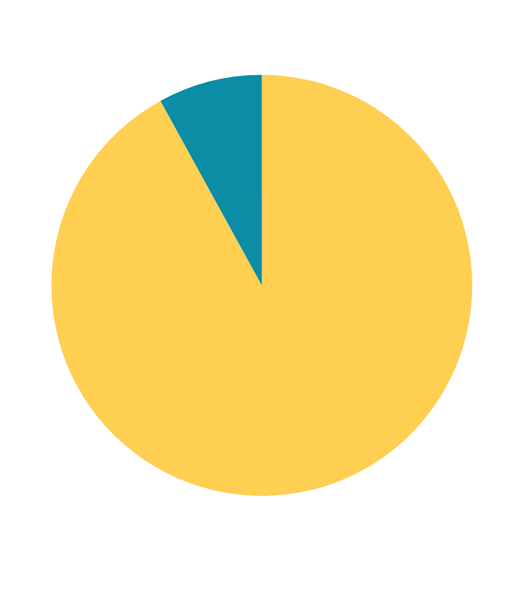
CLASS IMBALANCE
THE CORE CHALLENGE — A 92/8 CLASS SPLIT
92% repaid their loans. Only 8% defaulted. This extreme imbalance is the core modeling challenge.
Why This Is Dangerous
A model predicting that everyone repays achieves 92% accuracy but catches zero defaulters. Accuracy is misleading when classes are imbalanced — we need Recall.
Solution: SMOTE
Synthetic Minority Oversampling applied only to training data. Generates synthetic defaulter examples to balance classes, preventing the model from ignoring the minority class.

Slide 5

DATA QUALITY
HANDLING MISSING VALUES
Missing bureau values often indicate no external credit history rather than data errors. Features exceeding 60% missing rate were dropped to preserve model integrity and avoid noise amplification.
122 Original Columns
~67 After Dropping High Missing
147 After Dataset Merging

Slide 6
FEATURE DISTRIBUTIONS
WHICH FEATURES SEPARATE DEFAULTERS FROM REPAYERS?
A 3×3 grid of histograms compares the distribution of key features between repayers (teal #0D7B6A) and defaulters (red #C0431A). Features include: AMT_INCOME_TOTAL, AMT_CREDIT, AMT_ANNUITY, DAYS_BIRTH, EXT_SOURCE_1, EXT_SOURCE_2 (strongest predictor — highlighted with distinct border), EXT_SOURCE_3, DEBT_TO_INCOME, and ANNUITY_TO_INCOME.
EXT_SOURCE_2 shows the clearest separation between classes, making it the single strongest predictor in the dataset. External credit scores, applicant age (DAYS_BIRTH), and debt-to-income ratios consistently differ between defaulters and repayers, providing strong discriminatory signal for the XGBoost model.
EXT_SOURCE_2 — Strongest Predictor
DAYS_BIRTH — Age Risk Signal
DEBT_TO_INCOME — Engineered Feature
AMT_CREDIT — Loan Size Indicator

Slide 7
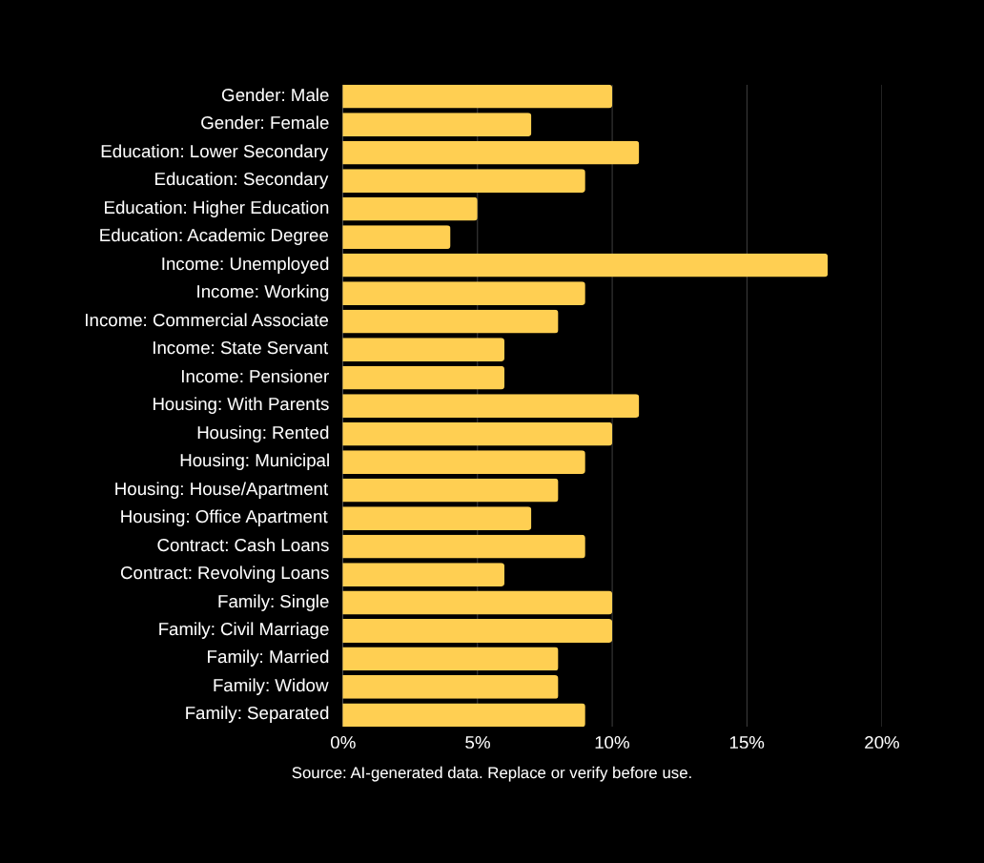
DEFAULT RATE BY CATEGORY
WHO DEFAULTS MORE?
Categorical risk patterns across Gender, Education Type, Income Type, Housing Type, Contract Type, and Family Status. Gold line marks the 8.07% average default rate across all applicants.
Unemployed applicants default 2–3× the average rate
Lower education levels significantly increase default risk
Cash loans default more often than revolving credit

Slide 8

AGE AND
CREDIT SCORE SIGNALS
Applicants aged 20–25 default nearly twice the average rate. EXT_SOURCE_2 is the single strongest protective feature in the dataset, with higher scores strongly predicting repayment.
01
Applicants aged 20–25 show the highest default rate — nearly 2× the 8% average. Risk declines steadily with age.
02
EXT_SOURCE_2 has the strongest negative correlation with default (−0.16), followed by EXT_SOURCE_3 and EXT_SOURCE_1.

Slide 9

PAYMENT
BEHAVIOUR
Distribution of payment lateness (days late) reveals a strong behavioural signal separating defaulters from repayers. Late payments are the most predictive behavioural indicator in the dataset.
01
DEBT_TO_INCOME | ANNUITY_TO_INCOME | CREDIT_TO_GOODS — Core ratio features capturing financial burden relative to income.
02
PAYMENT_RATE | INCOME_PER_PERSON | INST_PCT_LATE ★ Strongest Predictor — % of installments paid late, engineered from payment history.

Slide 10

MODELLING APPROACH
THREE MODELS, ONE CLEAR CHAMPION
Workflow Pipeline:
Train/Test Split → Preprocessing → SMOTE → Model Training → Hyperparameter Tuning → Evaluation
SMOTE applied only to training data to address 92/8 class imbalance. Stratified split preserves target distribution.
Logistic Regression
Baseline linear model
Random Forest
Ensemble tree model

Slide 11

MODEL RESULTS —
XGBOOST BALANCED
THE CLEAR CHAMPION
Model Comparison: Recall | Precision | ROC-AUC
Dummy: 0% | N/A | 0.50
Logistic Regression: 60% | 19% | 0.69
Random Forest: 55% | 22% | 0.73
XGBoost Baseline: 65.8% | 17.6% | 0.7607
★ XGBoost Balanced: 76.5% | 15.0% | 0.7609
XGBoost Cost Optimized: 83.8% | 12.9% | 0.7605
Champion: XGBoost Balanced achieves the best ROC-AUC (0.7609) while catching 76.5% of all defaulters — maximising risk detection with strong discriminative power.

Slide 12

HYPERPARAMETER
TUNING
Optimizing scale_pos_weight to balance recall and precision. The selected value of 15.0 maximizes defaulter detection while maintaining acceptable ROC-AUC performance across all tested configurations.
15.0
Selected scale_pos_weight — highest Recall (76.5%) with ROC-AUC 0.7609. Optimal cost-sensitive configuration.
KEY
Insight: Missing a defaulter costs more than a false alarm. Higher weight penalizes missed defaults.

Slide 13
CONFUSION MATRIX
WHAT THE MODEL GETS RIGHT —
TN: 54,821 Correctly Identified Repayers
Predicted Repay → Actually Repaid. No financial loss. Model performs well on the majority class.
AND WHAT IT MISSES
TP: 1,876 Defaulters Caught
Predicted Default → Actually Defaulted. Recall = 76.5%. 76 out of every 100 defaulters identified and flagged before approval.
FP: 4,102 False Alarms | FN: 578 Missed Defaulters
FP: Predicted Default → Actually Repaid. Opportunity cost only.
FN: Predicted Repay → Actually Defaulted. Highest financial risk — loans approved that will default.
Key Takeaway: Recall 76.5% = 76 out of every 100 defaulters identified.

Slide 14

CROSS VALIDATION
IS THE MODEL GENUINELY GOOD — OR JUST LUCKY?
5-fold cross validation confirms XGBoost Balanced performs consistently. ROC-AUC remains stable at ~0.76 across all folds, and Recall stays near 76.5%, demonstrating the model generalises well to unseen data and is not overfitting.
ROC-AUC: 0.758 – 0.763 across 5 folds
Recall: 74.9% – 78.1% — consistently high
Low variance confirms no overfitting detected

Slide 15

OPENING THE BLACK BOX —
EXPLAINABLE AI WITH SHAP
SHAP (SHapley Additive exPlanations) transforms the XGBoost model from an opaque black box into a transparent, auditable decision engine. Every prediction is decomposed into individual feature contributions — enabling trust, compliance, and actionable insight across all stakeholders.
Global Explanations
Which features drive default risk across all applicants?
Local Explanations
Why was THIS specific applicant flagged as high risk?

Slide 16
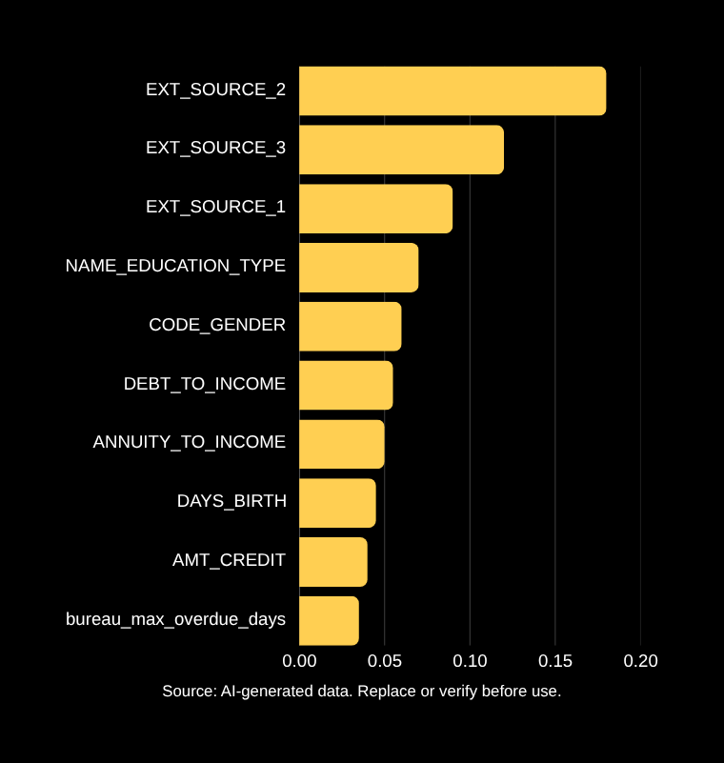
GLOBAL EXPLAINABILITY —
WHAT DRIVES DEFAULT
RISK MOST?
SHAP values measure each feature's contribution to the model's default prediction. Features ranked by mean absolute SHAP value across all applicants.
EXT_SOURCE_2 is the single strongest predictor — a composite external credit score. Higher values strongly reduce default probability. Scores below 0.35 are high-risk.
DEBT_TO_INCOME and ANNUITY_TO_INCOME are the top engineered features, confirming that repayment burden relative to income is a critical risk signal for Kenyan digital lenders.

Slide 17

LOCAL EXPLAINABILITY —
WHY WAS THIS
PERSON FLAGGED?
Risk Factors (pushing toward default):
• Low EXT_SOURCE_2 — weakest credit score signal
• High DEBT_TO_INCOME — debt burden exceeds safe threshold
• Late Payments — history of delayed installments
• Unemployed — no stable income source
Protective Factors (reducing default risk):
• Property Ownership — asset collateral present
• Stable Housing — permanent residence registered
• These factors partially offset risk but are insufficient to reverse the prediction.
Final Decision: 74% Default Probability → REJECT
SHAP base value: 0.08 (population average). Each feature contribution shifts the score toward or away from default. This applicant's risk drivers outweigh protective factors by a significant margin.

Slide 18
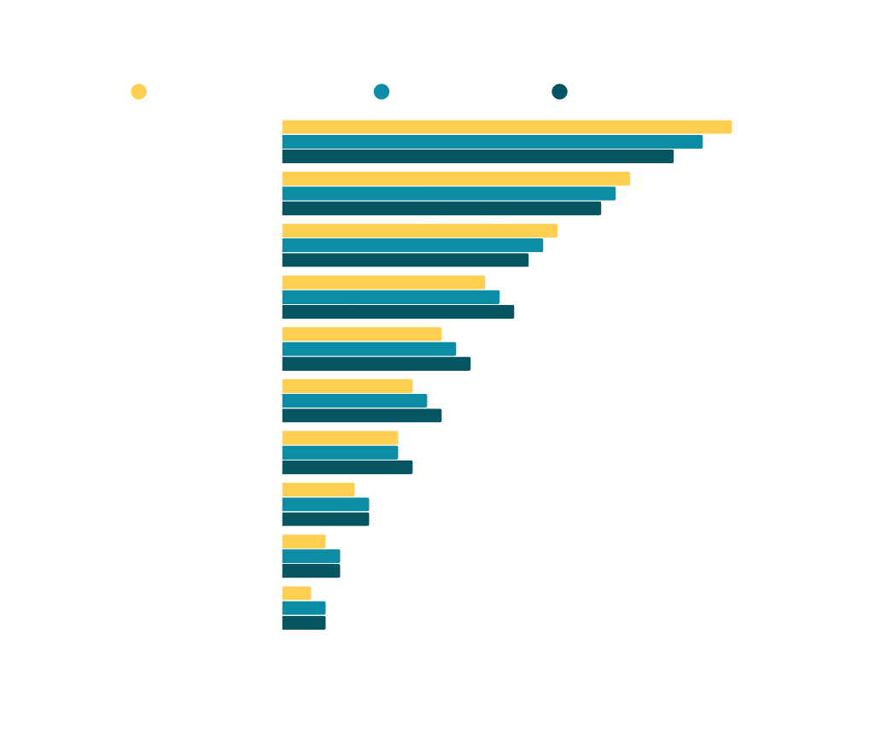
FEATURE IMPORTANCE COMPARISON
THREE METHODS AGREE
Random Forest, SHAP, and Permutation Importance all converge on the same top predictors — validating model reliability and explainability across methods.
EXT_SOURCE_2 Ranks #1
DEBT_TO_INCOME Consistent
DAYS_BIRTH in Top Features

Slide 19

SHAP DEPENDENCE PLOTS
THRESHOLD EFFECTS — WHERE RISK CHANGES DRAMATICALLY
EXT_SOURCE_2 and EXT_SOURCE_3 show clear threshold effects on default probability. Below 0.35, risk rises sharply — triggering manual review. These thresholds form the basis of the lending policy framework.
01
EXT_SOURCE_2 threshold at 0.35 — below this, default probability spikes. Applicants scoring above 0.60 qualify for Fast Track Approval.
02
Policy: Below 0.35 → Manual Review | 0.35–0.60 → Standard Review | Above 0.60 → Fast Track Approval.

Slide 20
BUSINESS RECOMMENDATIONS
FROM MODEL INSIGHTS TO LENDING POLICY
Credit Score Threshold: Applicants with EXT_SOURCE_2 below 0.35 should be flagged for manual review. This single feature is the strongest predictor of default and should anchor all risk-based lending decisions.
Annuity-to-Income Cap: Reject or escalate applications where annuity-to-income ratio exceeds policy threshold. High repayment burden relative to income is a consistent driver of default across all model iterations.
Payment History Screening: Applicants with INST_PCT_LATE above threshold should receive enhanced scrutiny. Late payment patterns are the strongest behavioural signal of future default risk identified in the data.
Age-Based Risk Adjustment: Apply stricter criteria for applicants aged 20-25, who default at nearly twice the average rate. Consider reduced credit limits or additional income verification for this segment.
Credit Score Threshold
Annuity-to-Income Cap
Age-Based Risk Adjustment
Model Monitoring

Slide 21
LIMITATIONS
WHAT THIS MODEL CANNOT DO — HONEST BOUNDARIES
The following limitations are acknowledged transparently. Each has a corresponding mitigation strategy to guide responsible deployment and future improvement.
01
Non-Kenyan Dataset — Trained on Home Credit data, not local Kenyan lending data.
Mitigation: Retrain on Kenyan data once labeled dataset is available.
05
Fairness Concerns — Gender and age features may introduce bias.
Mitigation: Conduct fairness audits; test disparate impact across protected groups.
02
Low Precision — 15% precision means many false positives; good borrowers flagged.
Mitigation: Use risk tiers and manual review for borderline cases.
06
Third-Party Credit Bureau Dependence — EXT_SOURCE features are external scores.
Mitigation: Build internal behavioral scoring as fallback; reduce reliance on single source.
03
Model Drift — Borrower behavior changes over time; model accuracy degrades.
Mitigation: Schedule quarterly retraining and monitor prediction distributions.
04
Synthetic SMOTE Data — Oversampling may introduce artificial patterns.
Mitigation: Validate on original unsampled test set; compare with cost-sensitive learning.

Slide 22
WHAT WE BUILT —
AND WHAT IT MEANS
SUMMARY | XGBoost Balanced — Champion Model
✦ 5 Datasets Merged ✦ 147 Features Engineered ✦ 6 Custom Features Built
✦ 3 Models Compared ✦ SHAP Explainability Applied ✦ 5-Fold Cross-Validation
Key Results: 76/100 Defaulters Caught | ROC-AUC: 0.7609 | Recall: 76.5%
NEXT STEPS
▶ Retrain on Kenyan-specific lending data for local market accuracy
▶ Build Flask API to deploy model into live credit scoring pipeline
▶ Create interactive SHAP dashboard for loan officers and risk managers
▶ Conduct A/B testing against current manual approval process
GitHub: KimutaiHub | Moringa School Phase 4 | Kimutai Kevine
76/100 Defaulters Caught
0.7609 ROC-AUC Score
147 Features | 5 Datasets
XGBoost Balanced Champion

Slide 23
THANK YOU
For Your Attention
EXPLAINABLE LOAN DEFAULT RISK PREDICTION
GitHub
Presenter
github.com/KimutaiHub
Kimutai Kevine

